Slide 1
Introduction to Bioethics
Laura Guidry Grimes, MA, PhD (C)

Slide 2
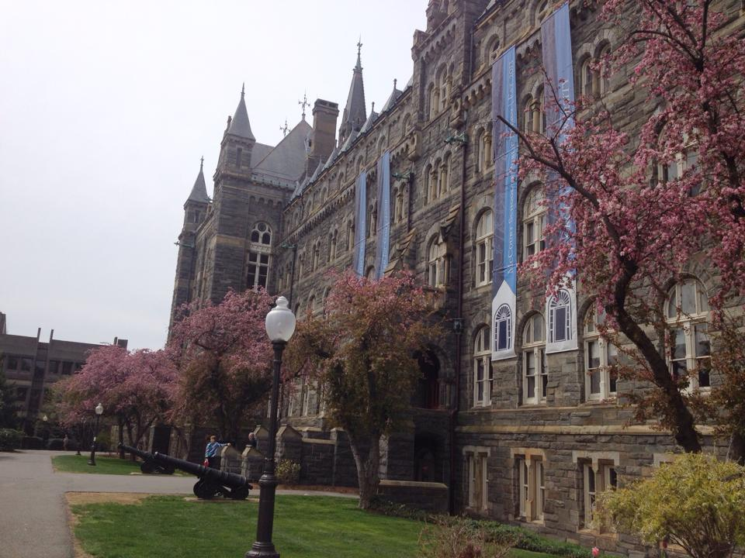
Game Plan
2:30-3:15
Introduction to ethics and bioethics
3:15-3:50
Small groups: case discussions
3:50-4:00
Break
4:00-4:30
Case analysis and problem-solving

Slide 3
Objectives
Upon completion of this session participants will be able to:
Understand the aims of ethical inquiry
Describe the birth of U.S. bioethics and U.S. principles of bioethics
Grasp at least one moral problem that pervades medical practice
Describe and critique what informs your moral judgments

Slide 4
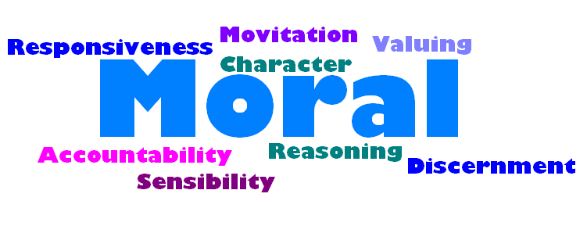
What Is Ethics?

Slide 5
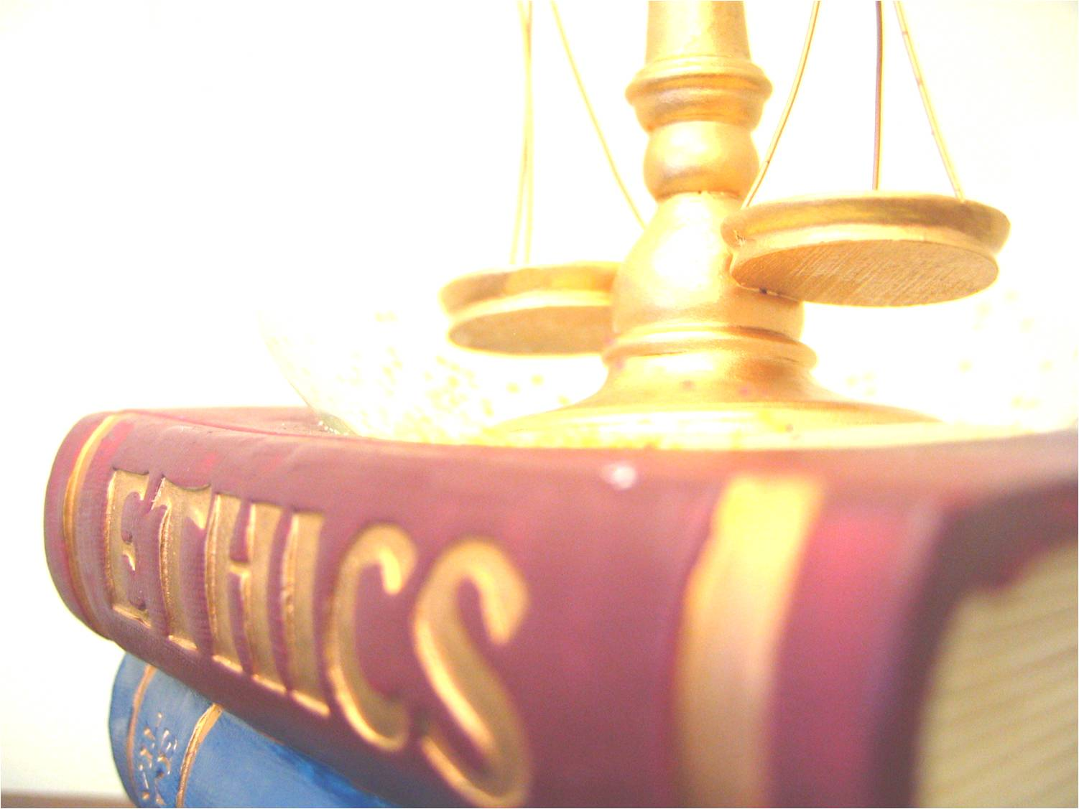
What Is Ethics?
Ethics is the formal, systematic study of what counts as the good, who we ought to be, what types of duties we have, and how we should judge right from wrong action.
Ethicists provide reasons for choosing one course of action over others.
  More than merely feeling something to be desirable, preferable
  Can be independent of religious and legal considerations

Slide 6
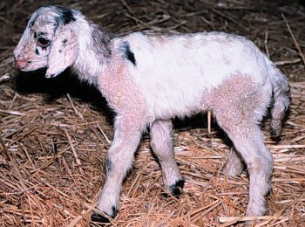
Descriptive vs. Normative
Descriptive claims concern what is, was, or could be
  Scientific inquiry, for example, seeks to accurately describe and predict phenomena that exist in the world or universe.
  Example: How do we genetically modify animals?
Normative claims concern what should be
  Facts matter to ethics, but the aim of ethical analysis is to figure out what should be the case (even if it does not actually turn out that way).
  Example: Should we genetically modify animals? What are the moral costs and moral benefits of the available options?

Slide 7

Moral Responsibility
  Comes in degrees
  Can range over individual and collective actions, motivations, intentions, attitudes, emotions, dispositions
  Can be responsible for action, omission, complicity, ignorance, unintentionally doing something, being part of an unjust system
  Can be responsible even when you “luck out”
  Can be mitigated by a number of factors
  Can be backward-looking (assign praise/blame) or forward-looking (make improvements for future)

Slide 8
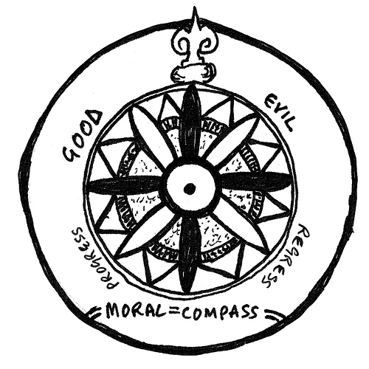
How Do I Promote Ethical Responses to Moral Problems?
Pay attention to how you reason as you think about how you should and would respond.
What counts as the right response?
  Promotes human dignity and the common good
  Maximize good and minimize harm
  Just distribution of goods and harms
  Respects rights
  Responsive to vulnerabilities
  Promotes virtue
  Other possibilities…

Slide 9
Moral Dilemma
Moral Prohibition
A
Moral Prohibition
B
OR
Moral Requirement A
Moral Requirement B

Slide 10
Moral Dilemma
Conflict between moral requirements or prohibitions
  Tragic when there is no way to resolve the dilemma
Moral residue is a byproduct of an unresolved moral dilemma
  Did something you must not do or did not do what you must
  → Problem of dirty hands
If you had the opportunity to be in a position of power where you would routinely face moral dilemmas (many of them tragic), would you accept the job, knowing that your hands would be dirtied as a result?

Slide 11
Questions? Comments?
Before we move on…

Slide 12
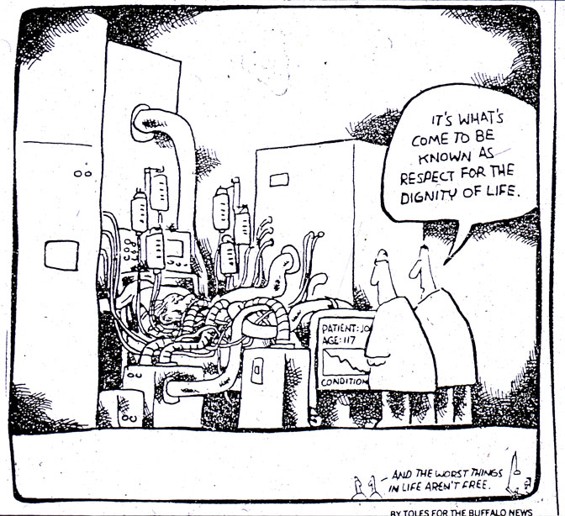
What Is Bioethics?

Slide 13
Bioethics:
Academic Field & Practice
What moral obligations do we have, individually and collectively, in our pursuit of advancement in medicine and biological science?
  How should biomedical science and patient care proceed?
  How should we address and prevent potential wrongdoing?
Includes research ethics, clinical ethics, and public health ethics
  Broadly, also includes environmental ethics and animal ethics

Slide 14
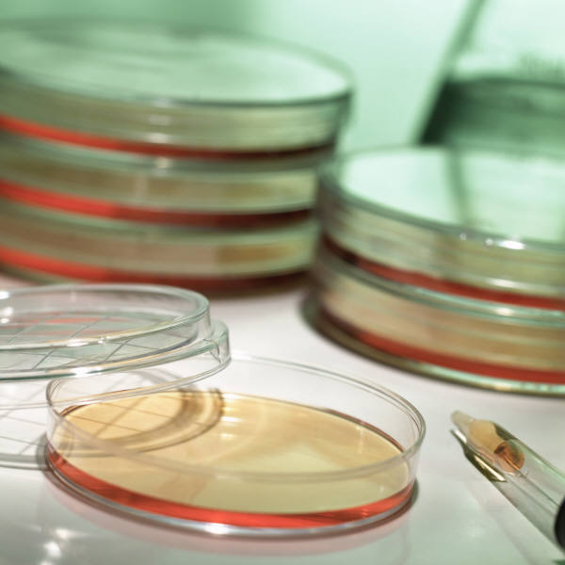
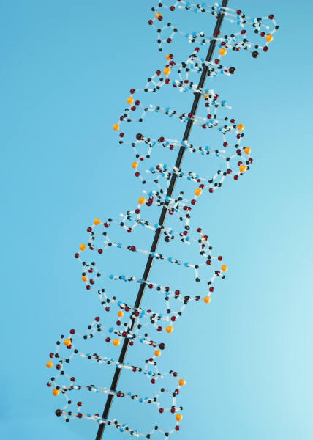
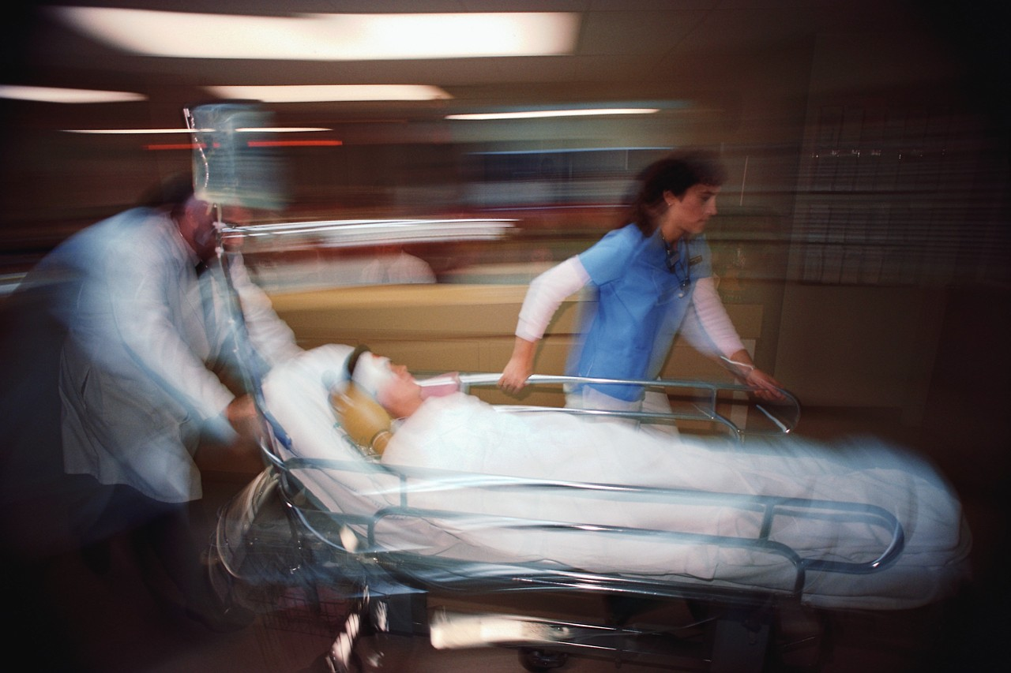
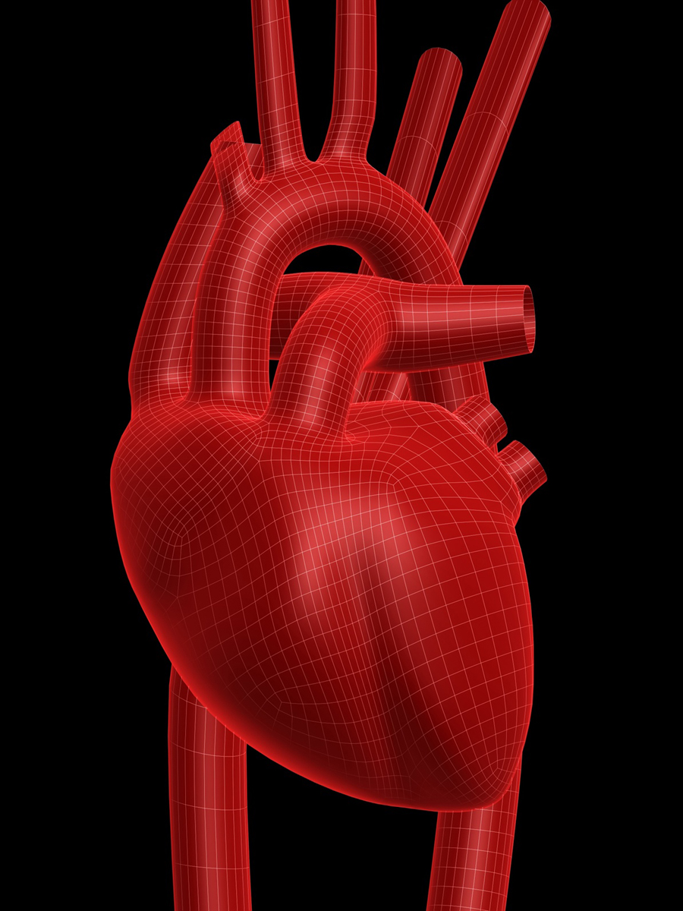
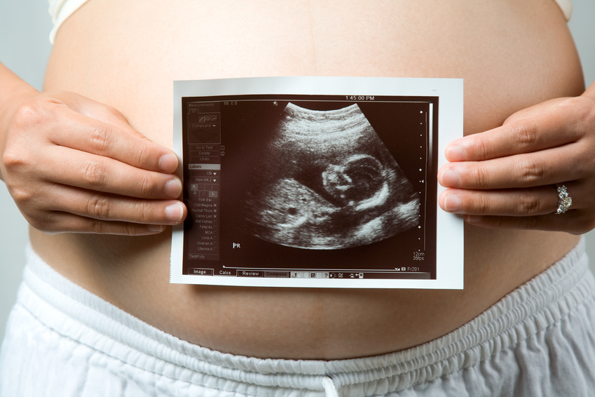
Topics in Bioethics
Some areas of ethical analysis:
  Reproduction and beginning of life
  Informed consent in research
  Public health surveillance
  Pharmaceutical advertising
  Enhancement, cosmetic & genetic
  Organ donation & transplantation
  End of life decisions
  Pediatric vaccinations
  Placebo use
  Conscientious objection

Slide 15
Birth of U.S. Bioethics
Dan Callahan
Cultural Developments
Civil rights movement
Rebirth of feminism
Fresh surge of individualism
New possibilities to combat disease, illness and death
New possibilities for changing the way human beings could live their lives
Scientific Developments
Kidney dialysis
Organ transplantation
Medically safe abortions & contraception
Prenatal diagnosis
Intensive care units
Shift from death at home to death in hospitals
First glimmerings of genetic engineering

Slide 16
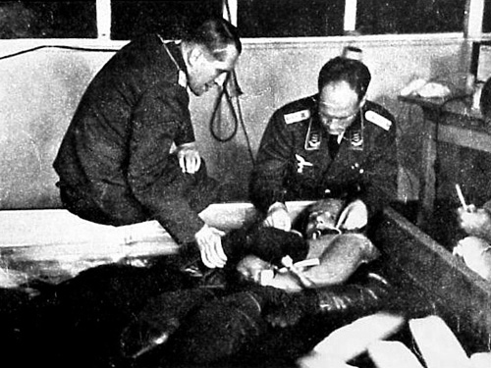
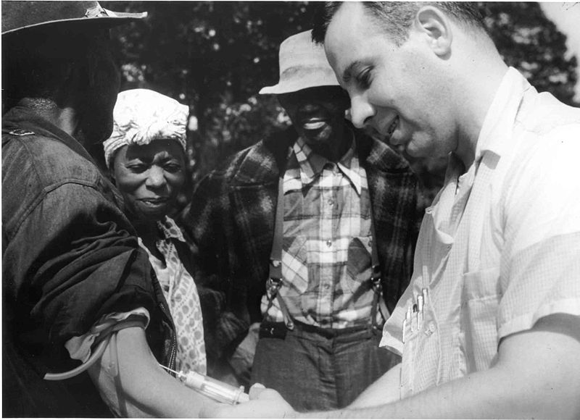
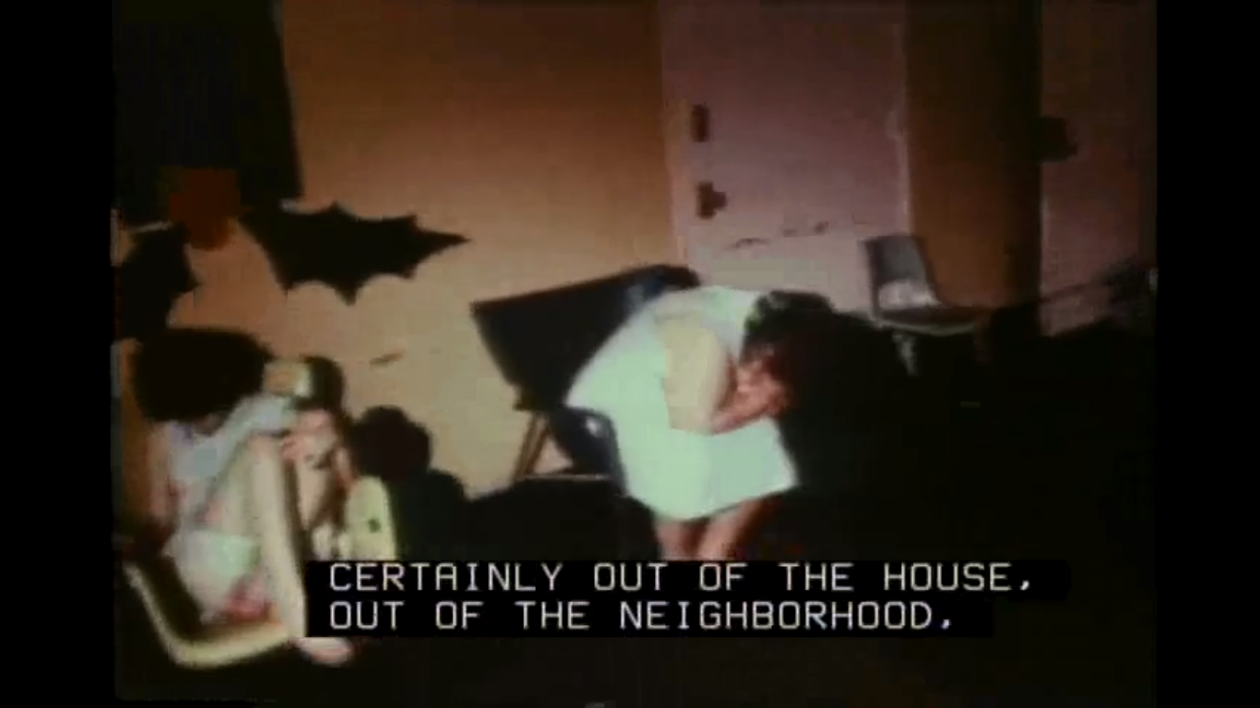
Controversy & Scandal
Nazi Experiments
  Painful, often deadly experiments on prisoners without consent -- often no scientific merit to studies
Tuskegee Syphilis Experiment (1932-1972)
  Poor, black sharecroppers with syphilis were not properly informed; research had racist assumptions
  Denied proper treatment, even after penicillin became readily available in 1947
Willowbrook Hepatitis Studies (1956-1971)
  Mentally disabled children in putrid conditions infected with live Hepatitis A – some treated with experimental drug, others were not
  Parents given misleading and coercive consent form

Slide 17
Principles of Bioethics
Autonomy
  1) Respecting, promoting, and supporting a person’s capacities for self-determination and 2) providing extra protections to those with diminished autonomy
Beneficence
  Strict obligation to maximize potential benefits, to do good by the patient/research subject
Nonmaleficence
  1) Strict obligation to minimize potential harms (medical and other) and 2) duty not to exploit vulnerable populations
Justice
  1) Equals ought to be treated equally, and 2) benefits and opportunities should be distributed fairly

Slide 18
Four Key Questions
NIH: Exploring Bioethics
What is the ethical question?
  Requires moral imagination and moral sensitivity
  Distinguish ethical, legal, scientific, and personal questions
What are the relevant facts?
  Scientific, social, and legal facts are needed to determine costs, benefits, risks

Slide 19
Four Key Questions
NIH: Exploring Bioethics
Who or what could be affected by the way the question gets resolved?
  Who has a stake in the outcome? – Consider his/her own perspective
  Could be an individual, a group, an institution, community at large
What are the relevant ethical considerations?
  What are the core issues? What are some other issues that should affect our evaluation?

Slide 20
Questions? Comments?
Before we move on…

Slide 21
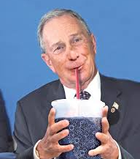
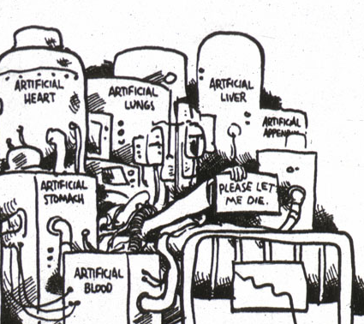
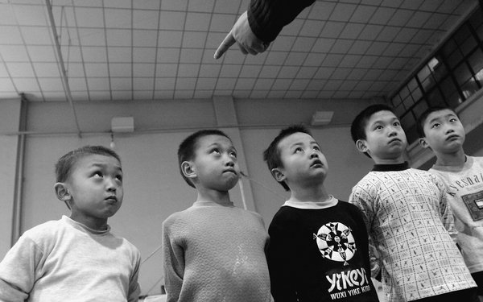
Discussion Groups
End of Life
Governmental Paternalism
Reproduction

Slide 22
Case Analysis & Problem-Solving

Slide 23
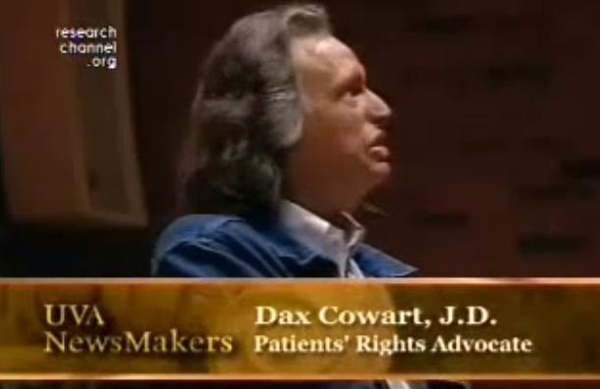
The Case of Dax Cowart

Slide 24
Conflicting Points of View
Dax’s stated reasons for wanting to die:
  Primary reason: Extreme, constant pain with minimal pain management
  Secondary reason: Could not imagine sufficiently worthwhile quality of life
Dr. Burt’s stated reasons for continuing treatment:
  Concern about autonomy running amuck
  Doctor’s business not to give up on a patient
From “Confronting Death Who Chooses, Who Controls?” by Dax Cowart & Robert Burt

Slide 25
Discussion
Do you think that Burt should have agreed to Dax’s request the first time? The second? After a month?
When is the decision to refuse treatment because of a disability sufficiently autonomous, informed, and voluntary?
  Are Dax’s concerns about pain more morally pressing than his concerns about lifelong disability?
How should a medical team advocate for Dax in this scenario? What would you have done as his doctor?

Slide 26
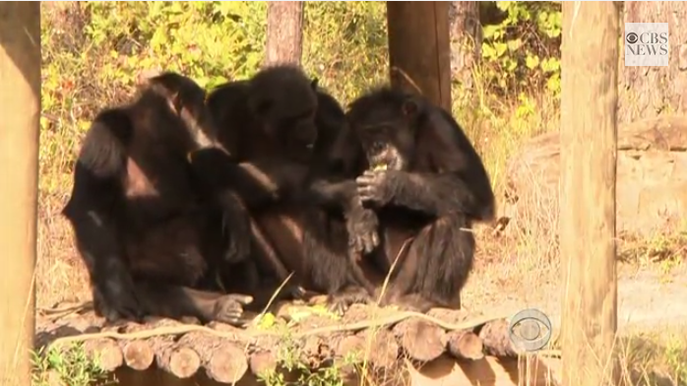
Research on Chimps
Notes:
In 2013, the National Institutes of Health announced that they would retire almost all of its chimps, which have been used in federally-funded research. The NIH made this decision because the Institute of Medicine determined that chimps were unnecessary for most research. Around 400 chimps used in private research will not be retired.

Slide 27
Spectrum of Positions:
Should We Research on Chimps?
Lenient:
Human interests nearly always outweigh animal interests
Demanding:
Human interests almost never carry significant weight
Middle Ground:
There are moral limits on animal use;
AND
b) Humans can use them when doing so advances significant human interests.

Slide 28
Discussion
How should we determine the moral limits of using non-humans in research? What are some key relevant factors?
Do you think that we owe anything (morally speaking) to animals used in research?
What do you think about the NIH’s decision to restrict chimp research? Would you go further and restrict other types of animal research?

Slide 29

Thank You!
Materials from this guest lecture can be found here:
http://gumedicalinstitute-bioethics.weebly.com

